Slide 1
Hidden Markov Model Submitted by – Kartik Nagras

Slide 2
What is an HMM?
A hidden Markov model (HMM) is a statistical model, in which the system being modeled is assumed to be a Markov process (Memoryless process: its future and past are dependent) with hidden states.

Slide 3
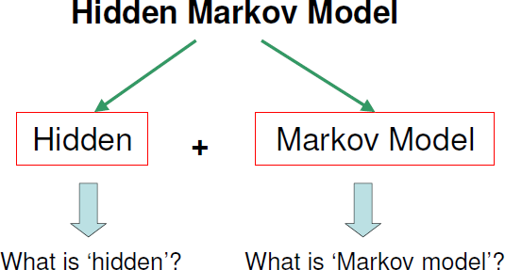
Hidden Markov Models

Slide 4
What is difference from regular Markov Model?
In a regular Markov Model, the state is directly visible to the observer, and therefore the state transition probabilities are the only parameters.
In an HMM, the state is not directly visible, but output which is dependent on the state, is visible.

Slide 5
Hidden Markov Model Parameters
The parameters of an HMM are of two types:
Transition Probabilities
Emission Probabilities(Output Probabilities)

Slide 6
Example
Alice and Bob live apart from each other and talk together daily over telephone about what did they do that day.
Bob is only interested in three activities:
Walking in the park
Shopping
Cleaning his apartment
His activities are dependent on the weather on a given day.

Slide 7
Example
Alice has no knowledge about how the weather is in where Bob lives. She tries to guess what the weather must have been like.
There are two states: “Rainy” or “Sunny”, but Alice cannot observe them directly, that is, they are hidden from her.
Since Bob tells Alice about his activities, those are the observations. The entire system is that of an HMM.

Slide 8
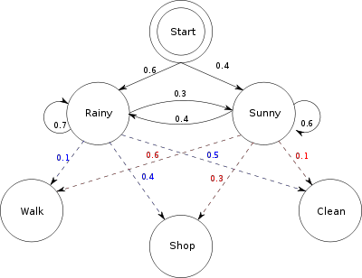
Probability Distribution

Slide 9
Example
Alice knows the general weather trends in the area, and what Bob likes to do on average. In other words, the parameters of the HMM are known.
start_probability: Alice’s belief about which state the HMM is in when Bob first calls her.
transition_probability: The change of the weather in the underlying Markov chain.
emission_probability: How likely Bob to perform a certain activity on each day.

Slide 10
Parameters
observations = ('walk', 'shop', 'clean')
start_probability = {'Rainy': 0.6, 'Sunny': 0.4}
transition_probability=
 'Rainy' : {'Rainy': 0.7,'Sunny‘:0.3},
 'Sunny' : {'Rainy': 0.4, 'Sunny': 0.6},
emission_probability =
 'Rainy' : {'walk': 0.1, 'shop': 0.4, 'clean': 0.5},
 'Sunny' : {'walk': 0.6, 'shop': 0.3, 'clean': 0.1},

Slide 11
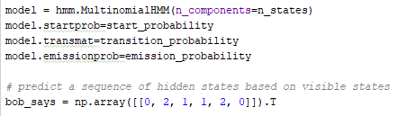
Input
Output

Slide 12
Major Applications
Speech recognition
Handwriting Recognition
Time Series Analysis
Activity recognition

Slide 13
Reference
Hidden Markov model. (2018, February 22). Retrieved February 27, 2018, from https://en.wikipedia.org/wiki/Hidden_Markov_model
H. (2017, October 08). Hmmlearn/hmmlearn. Retrieved February 27, 2018, from https://github.com/hmmlearn/hmmlearn

